Slide 1




the GrowSmarter project
2015-2019
Low Energy Districts
Replication Workshop Suceava
Cologne

Slide 2
Low Energy Districts
Cologne
Contents
Introduction
Cologne Low Energy Districts Overview
Low Energy Districts Solutions Cologne
Q + A

Slide 3
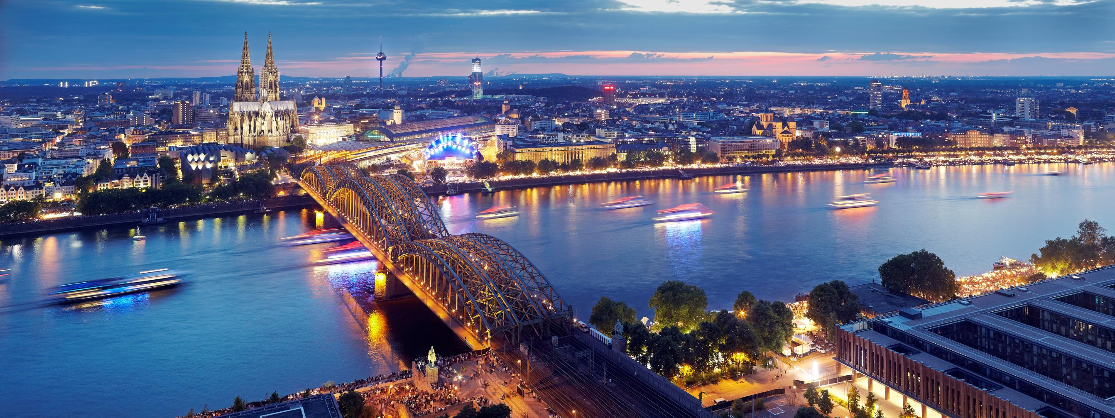
Low Energy Districts
Cologne

Slide 4

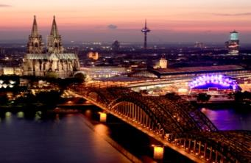
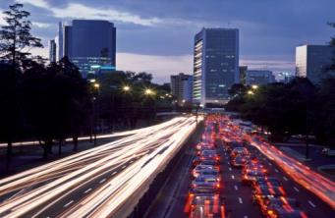
Low Energy Districts
Cologne
12 smart solutions
Low energy districts
Smart building shell refurbishment
Smart building logistics
Smart energy-saving tenants
Smart local electricity management
ICT
Integrated Infrastructures
5. Smart street lighting
6. Waste heat recovery
7. Smart waste collection
8. Big data management
Energy
Mobility
Sustainable urban mobility
9. Sustainable delivery
10. Smart traffic management
11. Alternative fuel driven vehicles
12. Smart mobility solutions

Slide 5
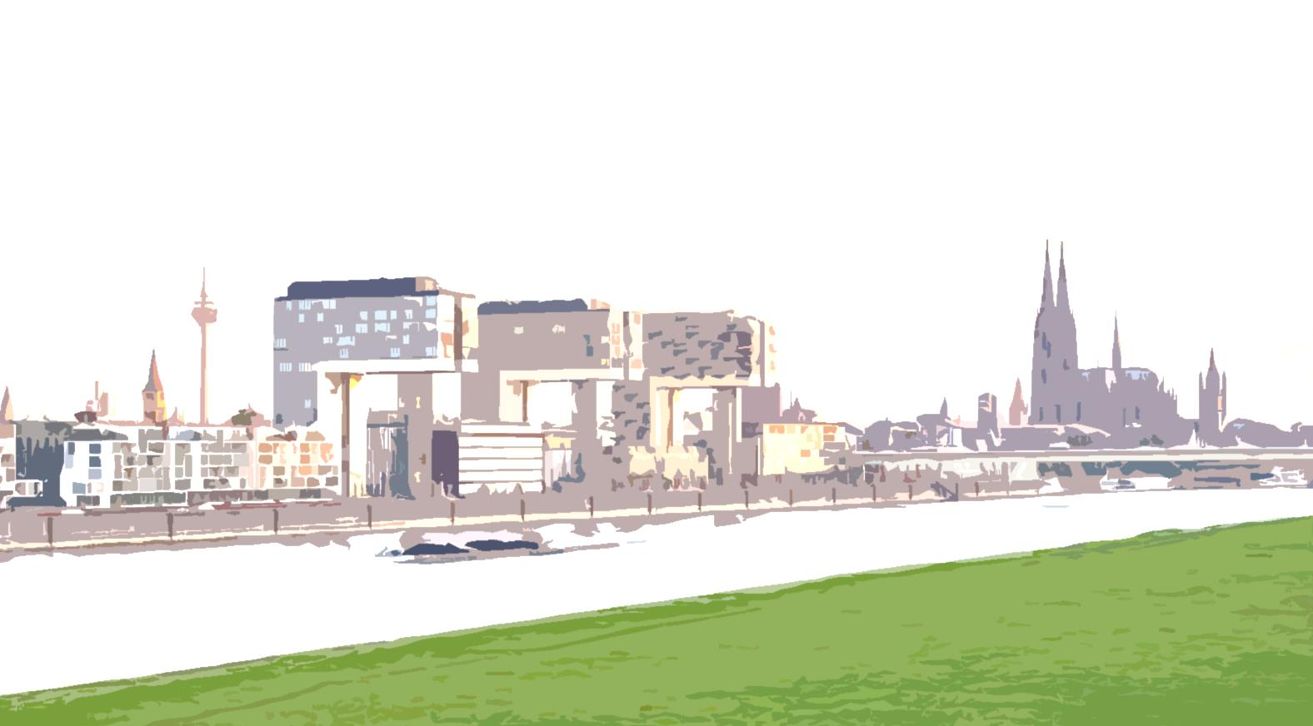
Low Energy Districts
Cologne
3.1 Smart Home
3.1 Green Air
4.1 VPP - Siedlungsmanagement

Slide 6
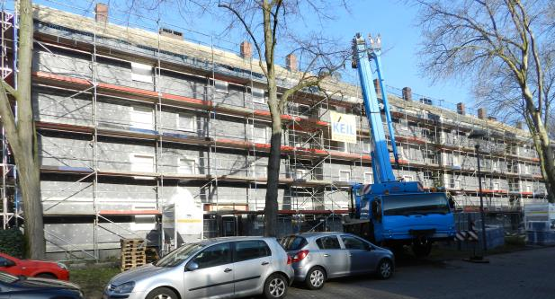
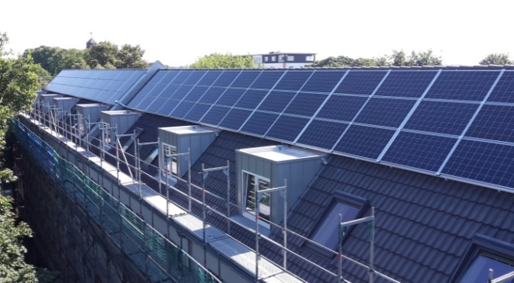
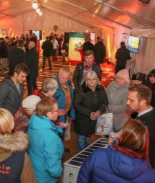
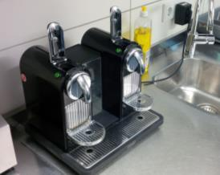
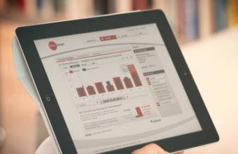
Low Energy Districts
Cologne
Goal: Energy reduction by 70 %
Implementation strategy
Use of renewable energies
Insulation
Photovoltaics
Heatpumps
Storage batteries
Efficient lighting
Behavioural change (Smart Home & Smart Plugs & GreenAir)
Virtual Power Plant (Siedlungsmanagement)

Slide 7
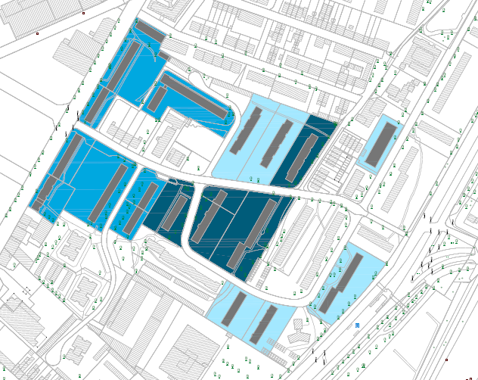
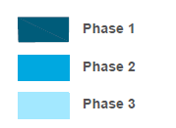
Low Energy Districts
Cologne
Stegerwaldsiedlung
3 phases in 3 yrs construction time
Project area
Mülheim
  16 apartment blocks
  ~ 33.500 m² living space
  > 700 residential units
  > 1.000 tenants

Slide 8
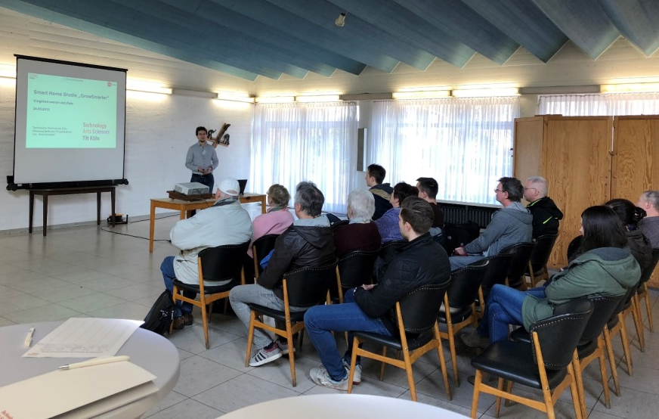
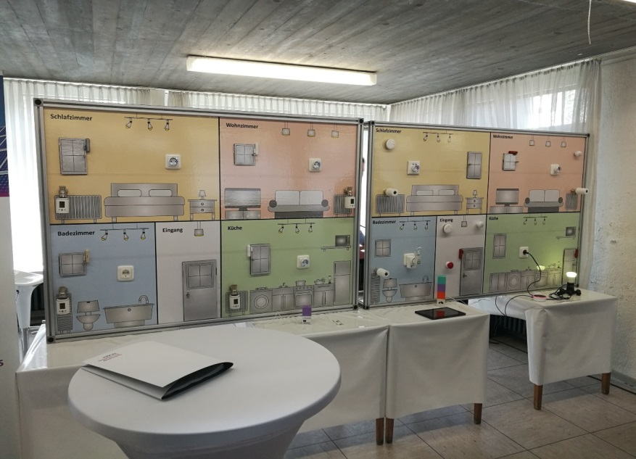

Low Energy Districts - SmartHome
Cologne
Innovative smart home system with components such as intelligent heating thermostats, window and door contacts and smart plugs
Information events in March & May 2018; all tenants of the project area were invited. Topics:
Mieterstrom-model and Smart Home system.
Low number of participants in the study despite door-to-door offers.
Notes:
We were surprised at the low number of participants.
The whole offer has, inclusive of installation, a value of about 1000 €.
The systems will become the property of the tenants upon completion of the study.
We contacted all tenants , our customers (about 80 %) even in person, and informed these about our offer and invited them to our information events.

Slide 9
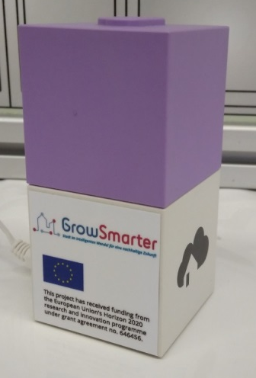
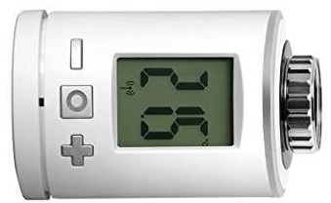
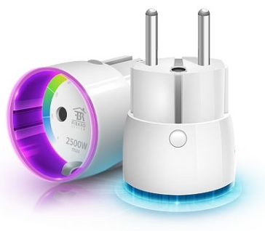

Low Energy Districts - SmartHome
Cologne
SmartHome system includes:
1x homee Brain Cube (Base station)
1x Z-Wave Cube radio protocol through which all devices can communicate with each other
5x Intelligent heating thermostats
5x Door- windowsensors
3x Smart Plugs
Notes:
Z-Wave is the radio protocol through which all devices can communicate with each other

Slide 10

Low Energy Districts - GreenAir monitoring system
Cologne
GreenAir offers a room-air-monitoring service with ventilation and heating recommendations
Sensors measure temperature and humidity (optional motion detection - security) & will be installed in the apartements.
Data transmission is carried out using innovative LoRaWAN technology.
The main advantages are:
Mold prevention
Better well-being
Lower heating costs
Notes:
If the humidity rises above a value of 60%, the tenant gets a push-message with a ventilation recommendation.
The tenant's behaviour can therefore be preventively influenced such that he/she has a better indoor climate, saves
heating costs and significantly reduces the risk of mould formation.
Planned for the future:
The landlord receives a dashboard, which allows him/her to monitor an overview of the conditions in the properties. In
the run-up, reasonable limits can be agreed with the landlord.

Slide 11
Low Energy Districts - GreenAir monitoring system
Cologne
If humidity rises above 60% : the tenant gets a push-message with a ventilation recommendation.
Influences behavior:
Managing better indoor climate
saving heating costs and
significantly reducing the risk of mold formation.
Future plans
Landlord dashboard to monitor the conditions in the properties.
Landlord & tenant can agree on reasonable limits.
Notes:
If the humidity rises above a value of 60%, the tenant gets a push-message with a ventilation recommendation.
The tenant's behaviour can therefore be preventively influenced such that he/she has a better indoor climate, saves
heating costs and significantly reduces the risk of mould formation.
Planned for the future:
The landlord receives a dashboard, which allows him/her to monitor an overview of the conditions in the properties. In
the run-up, reasonable limits can be agreed with the landlord.

Slide 12
Low Energy Districts
Cologne
Energy supply for:
    16 apartment blocks
    ~ 33.500 m² living space
    > 700 residential units
    > 1.000 tenants
PV-modules on all roofs (~5.600 m², 875 kWp)
41 air-water heatpumps (429 kWth)
District heating for peak loads (1.743 kW)
16 battery storage units (210 kW, 655 kWh)
Stegerwaldsiedlung
Project area
Mülheim

Slide 13
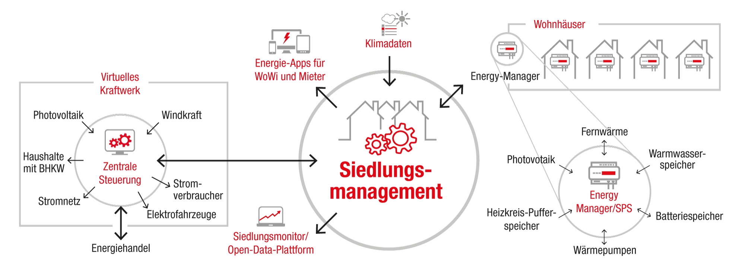
Low Energy Districts - Siedlungsmanagement
Cologne
A cloud based energy management system for districts
Forecast with self-learning algorithms
Optimization with flexible goals
Connection to the RheinEnergie Virtual Power Plant
Schematic illustration

Slide 14
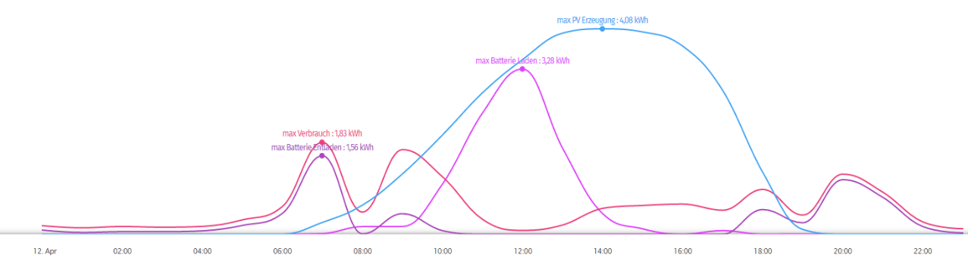
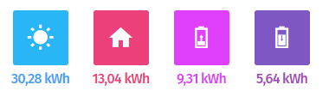
Low Energy Districts - Siedlungsmanagement
Cologne
Forecast is based on weather data and historic data from the plants.
The quality is improving due to self learning algorithms.
Forecast for:
  Electricity consumption
  PV production
  Heat consumption

Slide 15
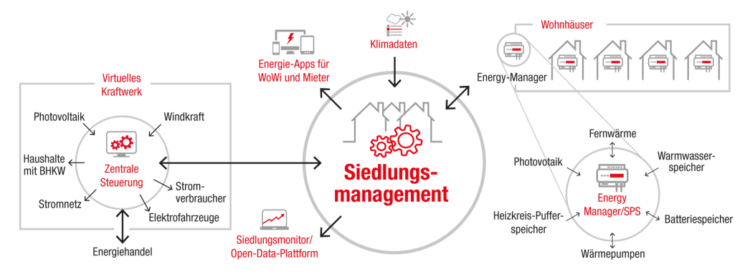
Low Energy Districts - Siedlungsmanagement
Cologne
  Optimization
  Based on the forecast the energy production and consumption can be optimized
  Working fully automated and continuously for the whole district
  Different goals can be set
    Minimize usage of district heating
    Minimize grid supply
    Minimize feed-in into grid
  The optimization creates schedules for the plants for each building

Slide 16
Low Energy Districts - Siedlungsmanagement
Cologne
  Connection to RheinEnergie’s VPP
  Based on the optimization, possible flexibility can be calculated
Available flexibility sent to RheinEnergie’s VPP
Based on the trading, result schedules are sent to the Energy Managers in each building
The schedules for all buildings are calculated every 15min for the next 36 hours

Slide 17
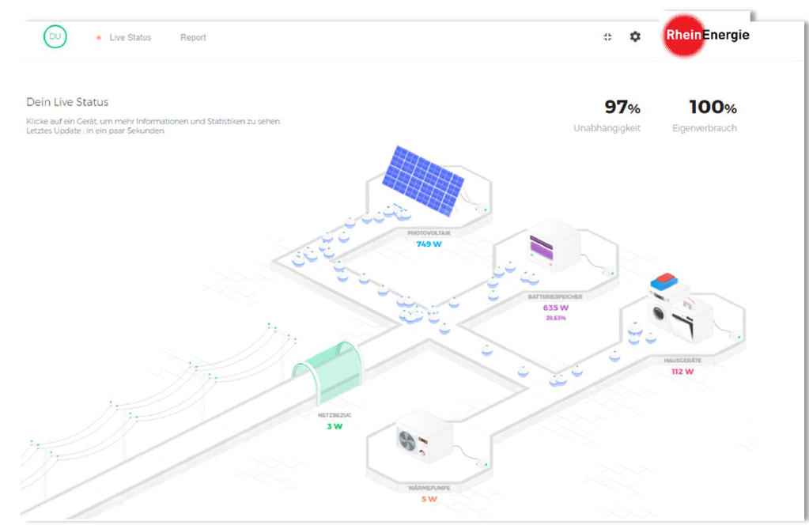
Low Energy Districts - Siedlungsmanagement
Cologne
  Visualization illustrating the flow of energy
DRAFT
Notes:
We have commissioned a visualization which illustrate the flow of energy
The values displayed have nothing to do with our settlement. This is only a draft at the moment. we are still in coordination

Slide 18
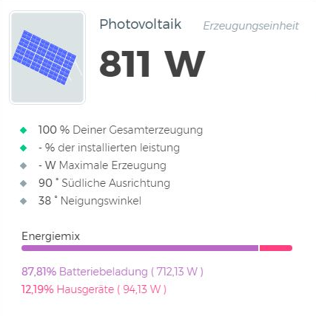
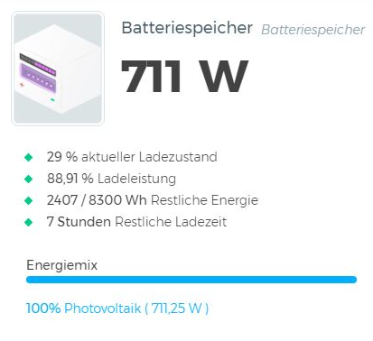
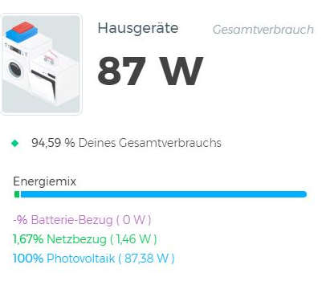
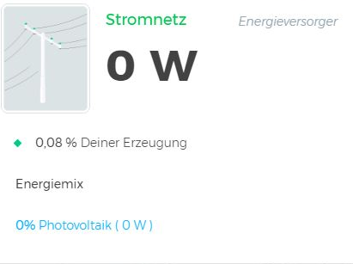
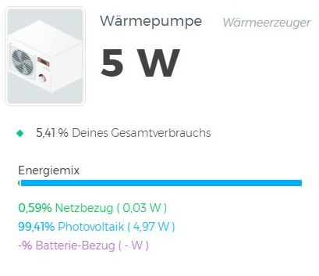

Low Energy Districts - Siedlungsmanagement
Cologne
  Detailed view of producers and consumers
DRAFT
Also available as analysis report
Notes:
you can get a detailed view of the producers and consumers. Information such as energy mix are displayed as well as performance and condition.
Its also possible to get these information in an analysis report.
The values displayed have nothing to do with our settlement. This is only a draft at the moment. we are still in coordination

Slide 19
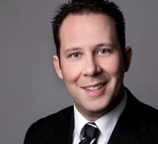
Christian Remacly
RheinEnergie AG
Parkgürtel 24
D-50823 Köln
Corporate Development
c.remacly@rheinenergie.com

Slide 20


Julia Egenolf
Tel +49 - 221 - 221- 29571
E-Mail julia.egenolf@stadt-koeln.de

